Slide 1



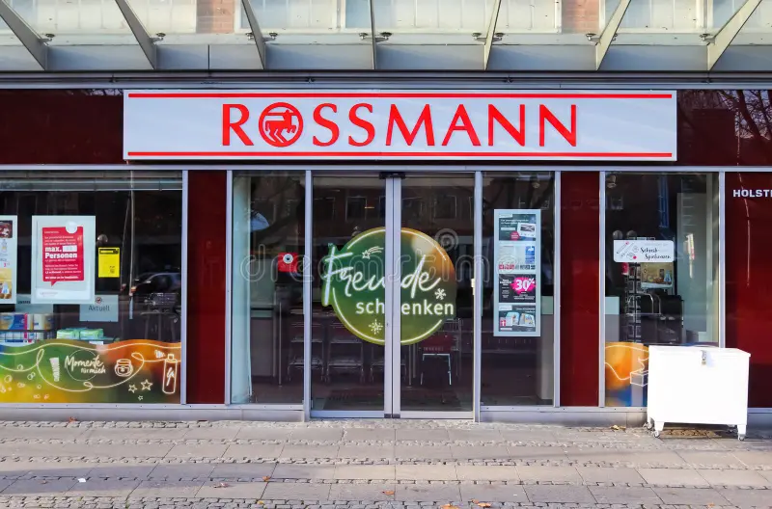
ROSSMANN
STORE SALES FORECASTING AND DEMAND PREDICTION
Presented by:
Asmaa Elsayed Mohamed Morsy
Aya Ahmed Kamal Abdulhameed
Marvel Baheeg Moneer Azmy
Yasmeen Esmail Mohamed Abdullah

Slide 2

BUSINESS PROBLEM STATEMENT
Rossmann relies on individual store managers for daily sales predictions, which leads to inconsistent forecasting and operational risks.
Managers also struggle to accurately measure the combined impact of complex factors such as promotions, holidays, seasonality, and nearby competition, making sales planning more difficult and less reliable.
Why Is This a Problem?
Underestimating sales may cause product shortages and long customer waiting times
Overestimating demand increases operational and inventory costs
Promotions and holidays create sudden sales spikes that are difficult to predict manually
Different store types and competition levels make forecasting even more complex across 1,115 stores
Poor forecasting directly impacts operational efficiency

Slide 3


Project Objectives
Perform data cleaning, preprocessing, and feature engineering to improve model qualityand Analyze the impact of promotions, holidays, seasonality, and competition on sales performance
Develop an accurate machine learning model to forecast daily sales for Rossmann stores.
Compare multiple machine learning models to identify the best forecasting approach.
Support data-driven decision-making for inventory planning, staffing, and business operations.

Slide 4

DATASET DESCRIBTION
The Rossmann dataset contains historical sales records collected from 1,115 Rossmann stores, with over 1 million daily sales records spanning several years.
The data combines daily operational sales information with detailed store-related attributes to help analyze the factors affecting sales performance.
Dataset Files
train.csv
Sales (Target)
StoreID
Customers
dayof week
Open (0,1)
Promo (0,1)
StateHoliday
(0,a,b,c)
SchoolHoliday (0,1)
Date
store.csv
StoreType (a,b,c,d)
StoreID
Assortment (a,b,c)
CompetitionDistance
Promo2
Promo2SinceWeek
Promo2SinceYear
PromoInterval

Slide 5

Data Cleaning&Preprocessing

Slide 6

Data Preprocessing Challenges
Problem 1 : Separate Datasets
Sales data and store metadata existed in separate files
Solution:
Merged:
train.csv
store.csv
using:
Store ID to create one unified dataset for analysis and modeling.
Problem 2 : Missing Values
Some store-related features contained missing values because:
Certain stores had no nearby competitors
Some stores did not participate in Promo2 campaigns
Solution:
Filled competition and promotion time features with 0
Replaced missing CompetitionDistance values using the Mean
Replaced missing PromoInterval values with: “No Promo”
modeling.

Slide 7
Data Preprocessing Challenges
Problem 3 : Inconsistent Data Types
The StateHoliday feature contained:
Integer 0
String "0"
Although both represented normal business days, the model would treat them as different categories.
Solution:
Standardized all values into one consistent categorical format.
Problem 4 : Incorrect Date Format
The Date column was stored as a string instead of a datetime format.
Solution:
Converted the column into:Datetime Format
This enabled:
Time-series analysis
Seasonal feature extraction
Trend analysis

Slide 8

Exploratory Data Analysis
(EDA)

Slide 9
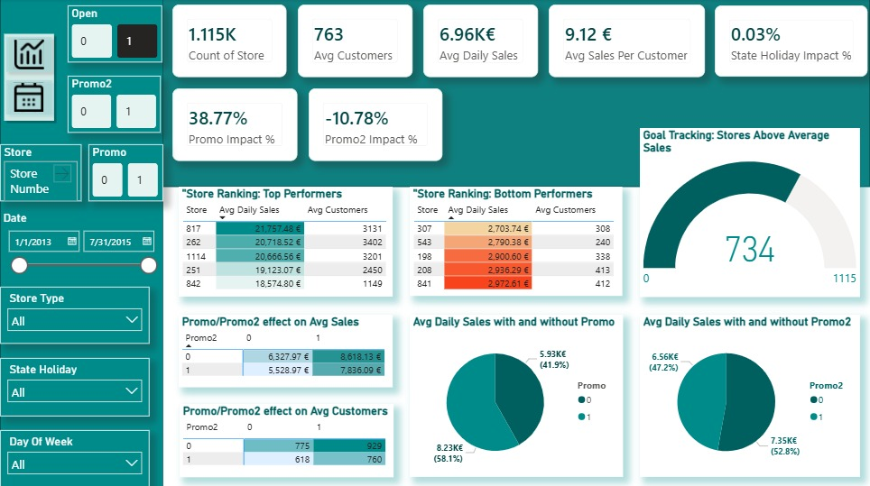

EDA via Dashboard — High-Level KPI Metrics

Slide 10
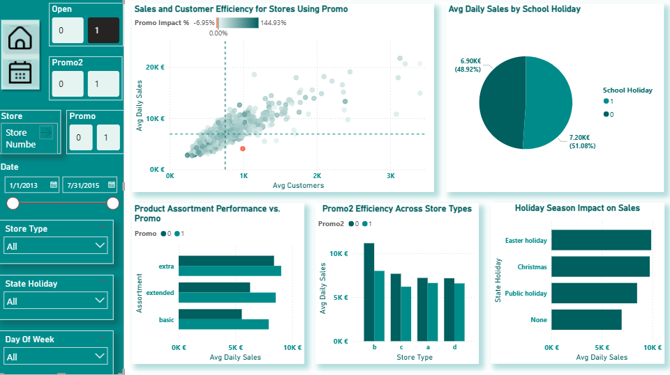
EDA via Dashboard — Promo & Holiday Efficiency

Slide 11
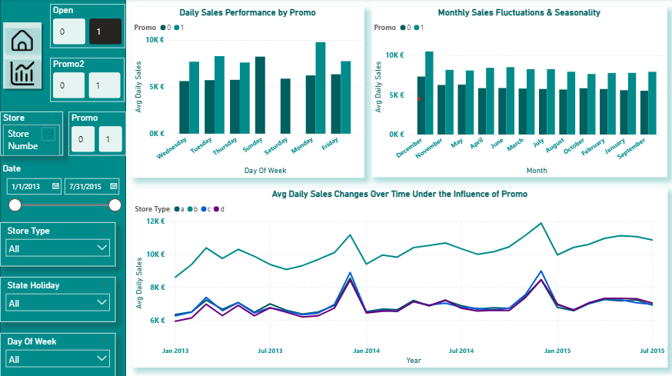
EDA via Dashboard — Time Series & Seasonality Trends

Slide 12



Christmas Surge (+40%)
Easter Peak (+42%)
9.74K€
9.89K€
Avg Sales (20 Stores Open)
Avg Sales (32 Stores Open)
Avg Customers: 1,569
Promo 1 Impact: No Promo
Avg Customers: 1,687
Promo 1 Impact: +70.82%
Sales per Customer: 6.21€
Sales per Customer: 5.86€
Promo 2 Impact: -37.11%
Promo 2 Impact: -35.26%
Public Holiday (+22%)
Not a Holiday
8.49 K€
6.95 K€
Avg Sales (156 Stores Open)
Avg Sales (1,115 Stores Open)
Avg Customers: 1,279
Promo 1 Impact : +7.98%
Avg Customers: 762
Promo 1 Impact : +38.81%
Sales per Customer: 6.64€
Promo 2 Impact: -26.65%
Sales per Customer: 9.12€
Promo 2 Impact: -10.74%

Slide 13

Feature Engineering

Slide 14

Feature Engineering: Time& Duration
Temporal Features
Calendar Elements: Extracted Year, Month, Day, and Week of Year from raw Date.
Seasonal Mapping: Mapped fiscal months to capture annual shifts in consumer buying habits.
Operational Duration Metrics
Competition Active Duration (CompetitionOpen_month): Tracks months since the nearest competitor opened. Helps model learn if competitor impact weakens over time.
Promotion Active Duration (Promo2Open): Measures months a store has been in Promo2. Captures customer fatigue or compounding campaign success.

Slide 15
Feature Selection & Leakage Prevention
Optimizing the Final Matrix
Dropped PromoInterval: Removed because its seasonal data was already captured by duration metrics.
Efficiency: Prevented memory overhead and ensured faster convergence for XGBoost.
CRITICAL: Removing Leaky Columns
Dropped Customers Feature: Highly correlated with Sales, but strictly unknown during inference and missing from test.csv.
The Goal: Mandatory step to prevent Data Leakage and guarantee realistic model evaluation in production.

Slide 16

Data Preparation

Slide 17
Data Splitting Strategy
Problem :Risk of Data Leakage & Unrealistic Evaluation
Solution: Chronological Time-Based Split
Time-Dependent Design: Strictly maintained the sequential timeline since sales are inherently chronological.
The Threshold: Established June 15, 2015 as the absolute cutoff date:
Training Partition: All historical data prior to this date.
Testing Partition: All subsequent future data reserved exclusively for evaluation.
The Operational Goal: Mimics an authentic production environment, forcing the machine learning model to forecast true, unseen future sales.
Traditional Random Splitting breaks the temporal order of retail sales data.
Allowing the model to train on random past and future days simultaneously creates artificial lookahead bias.
This results in deceptively high training accuracy but severe failure in real-world deployment.
---->

Slide 18
Feature Engineering: Categorical Encoding
Ordinal Encoding (Hierarchical Data)
Assortment Mapping: Converted levels into ordered weights based on product variety depth:
'a' (Basic) ---> 0
'c' (Extended) ----->1
'b' (Extra) ------> 2
Nominal One-Hot Encoding (Non-Ordered Data)
Targeted Columns: StoreType (layouts) and StateHoliday (holiday types) expanded into binary (0 or 1) columns.
Leakage Prevention: Strictly .fit() on training partition only; configured handle_unknown='ignore' for live evaluation

Slide 19
Feature Scaling Strategy
Problem :Skewed Feature Scales & Slow Training
Solution: Min-Max Scaling & Inversion
Raw features and the target variable (Sales) had vastly different numeric ranges.
This imbalance slows down gradient descent, causing unstable or extremely slow model convergence for neural networks and boosting algorithms.
Normalizations: Applied MinMaxScaler to compress all variables and Sales into a strict [0, 1]range for faster, optimal model training.
Inverse Transformation: Converted the final predictions back to the original Euro (€) scale to ensure realistic error calculations (MAE & RMSE).
---->

Slide 20

Model Training & Evaluation

Slide 21

Model Selection — The Deep Learning Challenge
The Problem: Is Deep Learning (LSTM) better for Time-Series?
Sequential data often suggests using LSTMs, but Rossmann’s data is highly tabular (Store Metadata, Competition distance, etc.).
The Result: Traditional LSTM failed significantly with only 20.00% Accuracy (R^2).
The Bottleneck: LSTMs require complex 3D sequential formatting and struggle to prioritize static tabular features compared to pure time-series data.
The Solution: Transition to Tree-Based Ensembles
Shifted focus from sequential deep learning to Tree-based algorithms which are inherently superior for structured, feature-rich tabular datasets.

Slide 22
How to handle sudden sales spikes (Promos/Holidays) and complex non-linear relationships across 1,115 stores?
The Solution: Random Forest vs. XGBoost
The Winning Solution — Tree-Based Ensembles
 | XG Boost
Random Forest
Test Accuracy (R²): 86.56%
MAE: 773€
RMSE: : 1111.98€
Test Accuracy (R²): 90.46%
MAE: 661€
RMSE: 936€
Strengths :
Captured nonlinear relationships well
Strong baseline performance
Strengths :
Better handling of complex feature interactions
Strong generalization capability
Reduced prediction error significantly

Slide 23
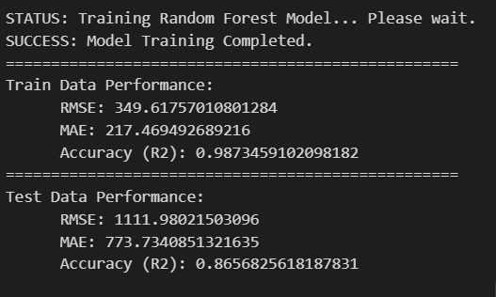
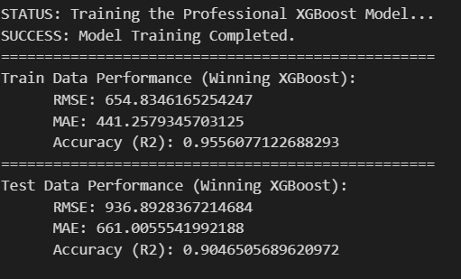
Model Predictions Comparison

Slide 24
Hyperparameter Tuning Strategy
To extract the maximum predictive power from our algorithms, we bypassed default parameters and implemented two distinct optimization paths:
RandomizedSearchCV (with Random Forest)
Why we used it:
Random Forest models take a significant amount of time to train on large data. RandomizedSearch was chosen for speed; it evaluates a fixed number of random parameter combinations from a broad distribution, finding an excellent approximate setup without crashing hardware resources.
Best Key Parameters Tuned: 'n_estimators': 100, 'min_samples_split': 5, 'min_samples_leaf': 2, 'max_features': 'sqrt', 'max_depth': 30

Slide 25
Hyperparameter Tuning Strategy
GridSearchCV (with XGBoost)
Why we used it:
Since XGBoost was our clear frontrunner, we chose the most meticulous method available. GridSearch systematically tests every single permutation of the parameter grid to guarantee we locked in the absolute mathematical global optimum.
Best Key Parameters Tuned: 'learning_rate': 0.02, 'max_depth': 10, 'n_estimators': 2000, 'objective': 'reg:squarederror', 'subsample': 0.9

Slide 26

MLOps & Experiment Tracking

Slide 27
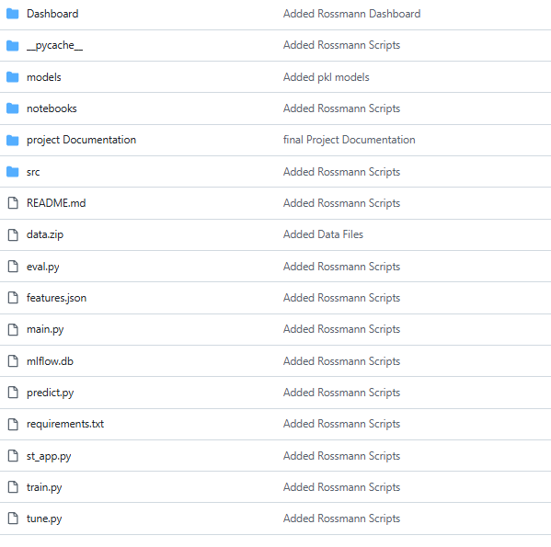
MLOps & Experiment Tracking
MLflow Integration
MLflow was used to track and manage the machine learning experiments throughout the project lifecycle.
Modular Project Architecture
The project was organized into separate modules for:
Data preprocessing
Feature engineering
Model training
Hyperparameter tuning
Prediction pipeline
Streamlit dashboard
Benefit
Improved:
Code organization
Scalability
Maintainability

Slide 28

Model Deploymemt
Via Streamlit

Slide 29
Model Deploymemt Via Streamlit
The final forecasting models were deployed using:Streamlit Dashboard to provide real-time sales prediction through an interactive user interface.
Dashboard Features
Sales prediction for future dates
Store and promotion configuration
Model comparison (XGBoost & Random Forest)
Interactive visualizations
Prediction Pipeline
User Inputs
→ Feature Processing
→ Trained Model
→ Sales Forecast
→ Dashboard Output

Slide 30
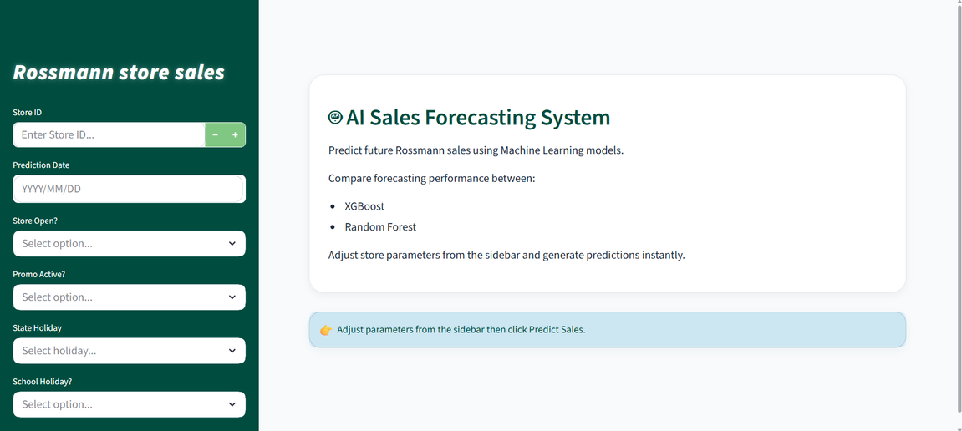
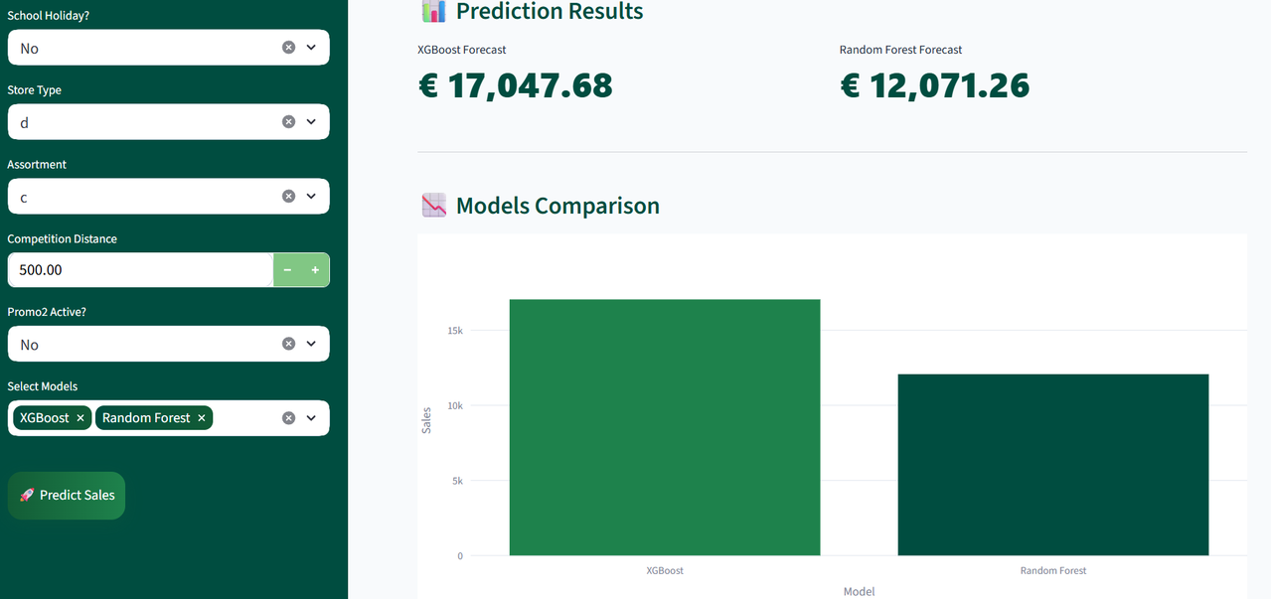
Model Predictions Comparison

Slide 31
THANK YOU !!!

